Slide 1
Team Basic Update #2
Gabriel Hearne, Logan Barger, George Pardes, Elijah Pettit

Slide 2
Accomplishments
Requirements: 9/9
Unit Tests: 22/24
Regression Tests: 22/24
Integration Tests 2/3
Acceptance Tests: 7/7
Milestones Complete 3/3
New Lines of Code: 744

Slide 3
In Depth Look
Upload/Download File -Elijah Pettit
3/3 requirements coded
Unit Tests Complete
Manual Complete
Download Wiki Page - Logan Barger
3/3 Requirements Complete
Unit Tests in Progress
Manual Written
Create New Account - George Paredes
3/3 requirements coded
Unit Tests Complete
Manual Written

Slide 4
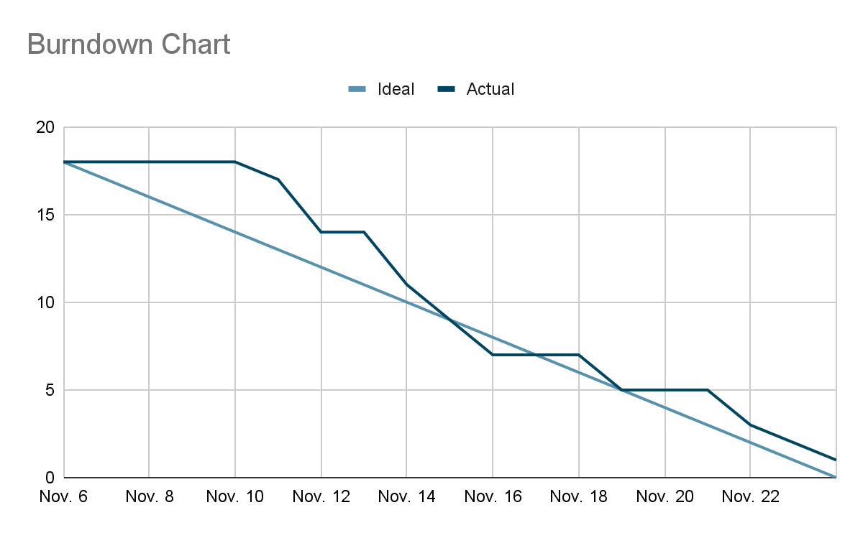

Slide 5
Upcoming and What’s Left
December 2: Project Due Date
December 4: Final Presentation
Todo
Organize final documents
Complete final presentation

